Slide 1
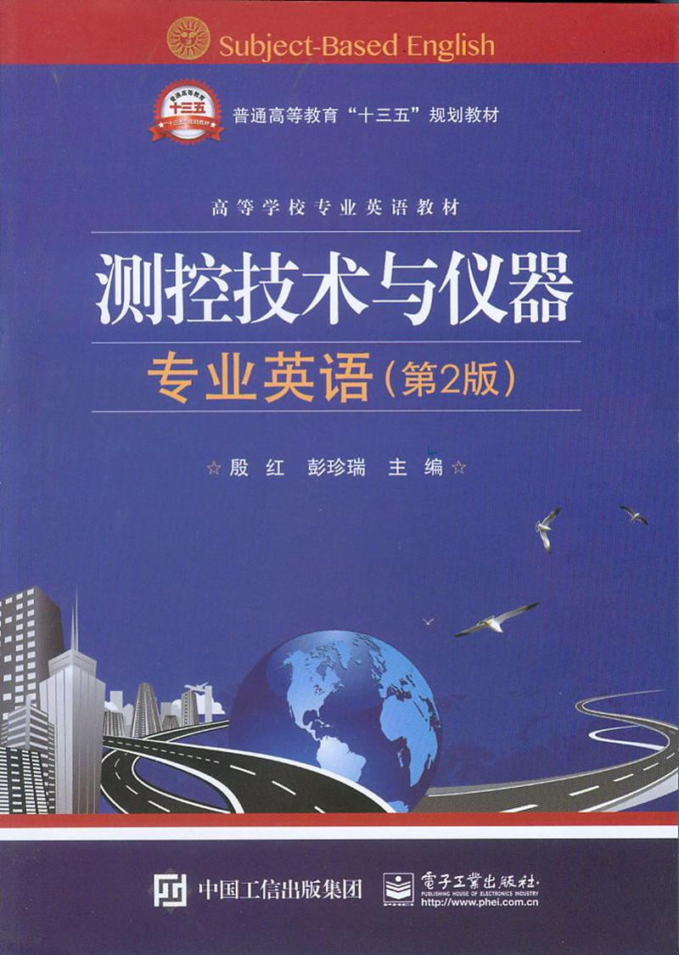
Unit4 Error Principle

Slide 2
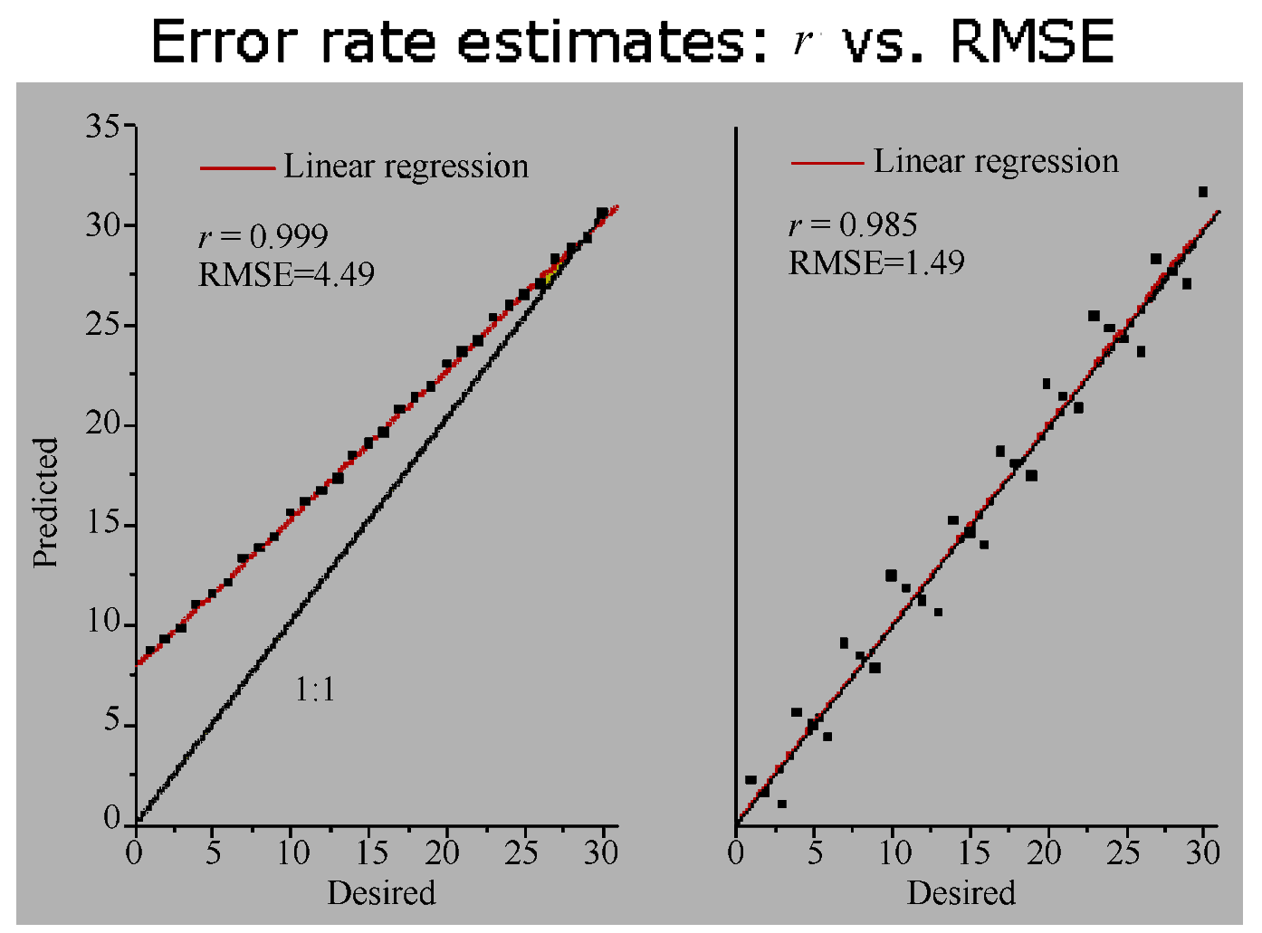
Unit4 Error Principle

Slide 3
Errors in measurement systems can be divided into those that arise during the measurement process and those that arise due to later corruption of the measurement signal by induced noise during transfer of the signal from the point of measurement to some other point.
句中that从句是those的后置定语从句，两个those是并列的宾语成分。
全句译为：测量系统的误差分为两种情况。一类是测量过程引起的，一类是在之后的信号由一个测量点传递到另一点的过程中，感应噪声引起测量信号的畸变。

Slide 4
The starting point in the quest(探求，寻找)to reduce the incidence of errors arising during the measurement process is to carry out a detailed analysis of all error sources in the system. Each of these error sources can then be considered in turn, looking for ways of eliminating or at least reducing the magnitude（量，量值，数量，尺度,大小，长度，重大，大量）of errors. Errors arising during the measurement process can be divided into two groups, known as systematic errors（系统误差）and random errors （随机误差）.
在测量过程中，寻求减小误差发生所产生的影响的起点是详细分析系统中的所有误差源。每个误差源都要依次考虑，寻找消除或减小误差值的方法。测量过程中产生的误差分为两类，即系统误差和随机误差。

Slide 5
1．systematic errors 系统误差
Systematic errors describe errors in the output readings of a measurement system that are consistently on one side of the correct reading, i.e. either all the errors are positive or they are all negative. Two major sources of systematic errors are system disturbance during measurement and the effect of environmental changes (modifying inputs).
句中positive和negative分别指值的“正”、“负”。
全句译为：系统误差描述了测量系统中输出读数始终在正确读数一边的误差，即所有误差均为正或均为负。系统误差的两个主要来源是测量中的系统干扰和环境改变的影响（改变输入）。

Slide 6
（1）System disturbance due to measurement
由测量引起的系统干扰
Thermometer（温度计）, which would initially be at room temperature, and plunge it into the water. In so doing, we would be introducing a relatively cold mass (the thermometer) into the hot water and a heat transfer would take place between the water and the thermometer. This heat transfer would lower the temperature of the water.
温度计最初置于室温，然后投入到水中。这样，我们将一个相对冷的质量（温度计）引入热水中，在水和温度计间发生了热传递。这种热传递将降低水的温度。

Slide 7
Whilst the reduction in temperature in this case would be so small as to be undetectable by the limited measurement resolution of such a thermometer, the effect is finite and clearly establishes the principle that, in nearly all measurement situations, the process of measurement disturbs the system and alters the values of the physical quantities being measured.
这是一个复杂长句。Whilst引导了让步状语从句。the effect是主语，后面跟了两个并列的谓语成分。that从句为the principle的同位语。
译为：虽然这种情况下温度降低如此之小，以致于无法由温度计的有限分辨率检测，但这种有限的影响清楚地证实了这样一个原理：几乎所有的测量环境中，测量过程干扰了整个系统，改变了被测物理量的值。

Slide 8
（2）Errors due to environmental inputs
环境输入引起的误差
An environmental input is defined as an apparently real input to a measurement system that is actually caused by a change in the environmental conditions surrounding the measurement system.
环境输入定义为测试系统表面上的实际输入，它实际产生于测试系统周围环境条件的改变。

Slide 9
The static and dynamic characteristics specified for measuring instruments are only valid for particular environmental conditions (e.g. of temperature and pressure).
static characteristic和dynamic characteristics指测量系统的“静态特性”和“动态特性”。
译为：测量仪器的静态特性和动态特性只在特定环境条件下有效（如温度和压力）。

Slide 10
The magnitude of this environment-induced variation is quantified by the two constants known as sensitivity drift and zero drift, both of which are generally included in the published specifications for an instrument.
句中constants意为“常数”，sensitivity drift意为“灵敏度漂移”，zero drift意为“零点漂移”，简称“零漂”。
译为：环境导致的变化量由两个常数确定：灵敏度漂移和零点漂移。两者通常都在仪器发布的产品说明书中给出。

Slide 11
（3）Wear（磨损，损耗）in instrument components
仪表元件的磨损
Systematic errors can frequently develop over a period of time because of wear in instrument components. Recalibration often provides a full solution to this problem.
因为仪器部件的损耗，每超过一段时间，系统误差会增加。再标定通常是解决这个问题最好的方法。

Slide 12
（4）Connecting leads （引线，引线脚）
In connecting together the components of a measurement system, a common source of error is the failure to take proper account of the resistance of connecting leads (or pipes in the case of pneumatically or hydraulically actuated measurement systems).
句中take proper account of意为“考虑”，connecting leads意为“连接线”。
译为：在测试系统各部件的连接中，常见的误差源是没有恰当考虑连接线（或气压、液压驱动测试系统的管线）的电阻。

Slide 13
For instance, in typical applications of a resistance thermometer, it is common to find that the thermometer is separated from other parts of the measurement system by perhaps 100 metres. The resistance of such a length of 20 gauge （直径，口径，码，厚度，规格） copper wire is 7 , and there is a further complication that such wire has a temperature coefficient （系数）of 1m /℃. Therefore, careful consideration needs to be given to the choice of connecting leads.
比如，在热电阻温度计的典型应用中，通常发现温度计与测试系统的其他部分相距大约100m。直径20GA、长100m铜线电阻为7 ，更麻烦的是这种导线有1m /℃的温度系数。因此，必须认真考虑选择连接线。

Slide 14
Not only should they be of adequate cross-section so that their resistance is minimized, but they should be adequately screened if they are thought likely to be subject to electrical or magnetic fields that could otherwise cause induced noise.
（连接线）不仅要有足够的横截面使电阻降到最小，而且在考虑到电磁干扰时要恰当屏蔽。

Slide 15
The prerequisite for the reduction of systematic errors is a complete analysis of the measurement system that identifies all sources of error. Simple faults within a system, such as bent meter needles and poor cabling practices, can usually be readily and cheaply rectified once they have been identified. However, other error sources require more detailed analysis and treatment. Various approaches to error reduction are considered below.
减小系统误差的首要条件是全面分析测试系统，以辨别所有的误差源。系统中的一些简单的缺陷，如仪表指针弯曲，不恰当的布线等，一旦被识别，通常很容易修正。然而，其他误差源要求更详细地分析和处理。减小误差的各种方法讨论如下：

Slide 16
（1）Careful instrument design精心的仪器设计
（2）Method of opposing inputs反向输入的方法
（3）High-gain feedback高增益反馈
（4）Calibration标定
（5）Manual correction of output reading输出读数的人工修整
（6）Intelligent instruments智能仪器

Slide 17
2. Random errors 随机误差
Random errors are perturbations of the measurement either side of the true value caused by random and unpredictable effects, such that positive errors and negative errors occur in approximately equal numbers for a series of measurements made of the same quantity.
随机误差是由随机和未知的影响引起的位于真值两边的测量的扰动量，对同一测量量的测量序列，正误差和负误差的值大约相等。

Slide 18
Such perturbations are mainly small, but large perturbations occur from time to time, again unpredictably. Random errors often arise when measurements are taken by human observation of an analogue meter, especially where this involves interpolation（篡改；添写；插补）between scale points. Electrical noise can also be a source of random errors.
这种扰动量大多都很小，但大的扰动量也时不时不可预知地发生。随机误差通常在测量人员观测模拟仪器时产生，尤其是在两个刻度点间插值读数时。电气噪声也是一种随机误差源。

Slide 19
Because of the nature of random errors and the fact that large perturbations in the measured quantity occur from time to time, the best that we can do is to express measurements in probabilistic terms: we may be able to assign a 95% or even 99% confidence level that the measurement is a certain value within error bounds of, say, ±1%, but we can never attach a 100% probability to measurement values that are subject to random errors.
句中from time to time意为“有时，偶尔”，confidence level意为“置信水平”。全句译为：鉴于随机误差的性质和测量值巨大的扰动量会时不时的出现，表达测量结果最好的方法是概率论：我们可以令置信概率为95%甚至99%，则测量值具有±1%的误差界，但由于随机误差的存在，测量值永远不能达到100%的置信概率。

Slide 20
（1）Mean and median values均值
However, for any set of n measurements of a constant quantity, the most likely true value is the mean given by:
在数学语言表达中，本句可表述为：然而，对一个常量的n个测量值 ，最接近真值的是均值，表为：…

Slide 21
（2）Standard deviation and variance
标准差和方差
Expressing the spread of measurements simply as the range between the largest and smallest value is not in fact a very good way of examining how the measurement values are distributed about the mean value. A much better way of expressing the distribution is to calculate the variance or standard deviation of the measurements.
将测量值的范围简单表达成最大与最小值之间的分布范围事实上不是检测测量值如何分布于均值周围的最好办法。表达这种分布更好的办法是计算测量结果的方差或标准差。

